Slide 1
Natural Language To SQL Generator
Team Details
P. Neetha Reddy (20EG105435)
M. Surya Teja (20EG105423)
Project Supervisor
B. Ravinder Reddy (Assistant Professor)

Slide 2
Introduction
Querying database through Structured Query Language(SQL) require knowledge in the field, hindering the accessibility for individual without expertise in the field. The challenges faced by Natural Language to SQL generator models, particularly in handling extensive datasets, have been a point of concern. These models, designed to simplify database interactions, often encounter inaccuracies due to limitations in their training data.
For the development of the model utilizes a novel dataset that consists of the user inputs and its corresponding queries. OpenAI API key is used to access the OpenAI’s Large Language Models, and jupyter notebook used for developing the model.
The application of this SQL query generator extends to individuals without expertise in the field required. It is useful to generate complex queries and is efficient to work with extensive datasets.

Slide 3
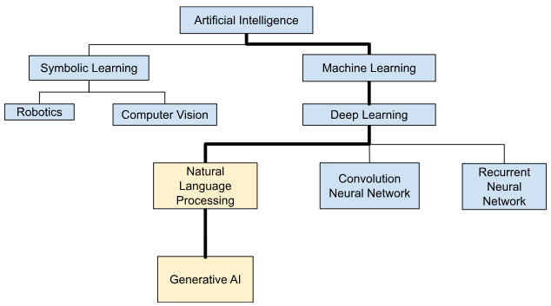
Concept Tree

Slide 4
Literature Survey
Sl.No | Strategies | Advantages | Disadvantages
1. | TypeSQL:Knowledge-based Type-Aware Neural Text-to-SQL Generation | TypeSQL generates SQL queries faster than some comparable models | Lack of accuracy when dealing with massive datasets.
2. | Robust Text-to-SQL Generation with Execution-Guided Decoding | Execution guidance significantly improves both syntactical and execution accuracy of the models. | Executing partially generated queries incurs additional computational overhead, potentially impacting real-world performance.
3. | Text to SQL Query Conversion Using Deep Learning: A Comparative Analysis | Outperforms rule-based and statistical approaches in terms of generating accurate SQL queries. | The models may not handle all possible SQL features, such as subqueries and complex data types.

Slide 5
4 | Querylizer: An Interactive Platform for Database Design and Text to SQL Conversion | The interactive approach helps minimize errors in schema design and query formulation compared to manual SQL coding. | The accuracy of generated SQL code relies heavily on the clarity and completeness of the user-provided text descriptions. Misinterpretation of text could lead to errors.
5 | M-SQL: Multi-Task Representation Learning for Single-Table Text2SQL Generation | Multi-task learning stabilizes training and makes the model less susceptible to specific query patterns or schema complexities. | M-SQL focuses on single-table scenarios and might not generalize well to complex queries involving multiple tables or joins.

Slide 6

Literature (selected strategy)
Sl.No | Author | Selected Strategies | Advantages | Disadvantages
1 | T Yu et. al. | Usage of OpenAI models | It doesn't need any training as they are based on human responses | Need to train them with the dataset.
2 | C Wang et.al. | Usage of LangChain | Helps in tokenization and fast processing | Difficulty in extraction due to complex words.
3 | T S et.al. | Prompting approach | User can interact with LLM using the prompts | need to build a precise model to user understanding
4 | A. Deshpande et. al. | structuring the query | LLM is already trained to structure the query | Explicitly structure the query
5 | X. Zhang et. al. | GPT-3.5-turbo | doesn’t leave any part of document of the user query | leaves complex sentences unanalyzed

Slide 7
Problem Statement
The barrier of learning programming languages for retrieving information from extensive databases. Existing methods often compromise on accuracy and struggle with managing large databases. The goal is to create an efficient text-to-SQL generator that enables users to interact with sizable databases without the need for extensive programming knowledge, ensuring both accuracy and scalability.

Slide 8
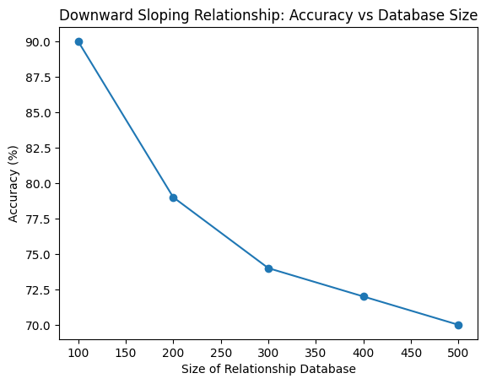
Problem Illustration
In the existing approaches, as the size of a database grows, the increased variability in the data may result in lower accuracy. The usage of more number of tables leads to less accurate results and increases the time of execution.
Accuracy problem in existing approaches
No of tables | No of tuples | Accuracy | Avg time of execution
1 | 240 | 0.875 | 2 ms
2 | 765 | 0.814 | 46 ms
5 | 1864 | 0.746 | 108 ms
8 | 7642 | 0.584 | 193 ms

Slide 9
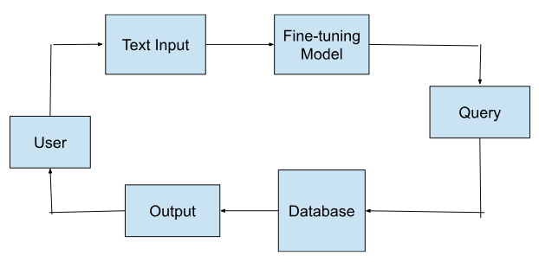
Proposed Method
It consists of 4 phases:
User Input - The schema and question are provided.
Processing - SQL query is generated based on the input.
Accessing database - The output is generated based on the query for the provided input.
Result - The output is displayed for the user.

Slide 10
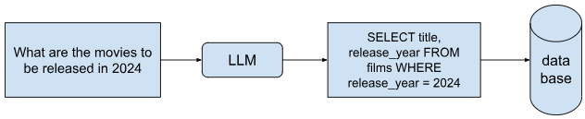
Proposed Method Illustration
The input provided by the user, is processed by the LLM to generate the SQL query, which access the database to obtain the required information.

Slide 11
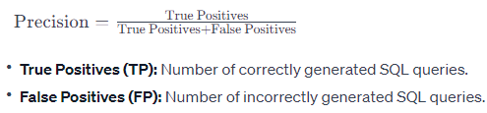

Parameters
Precision: Precision measures the accuracy of the generated SQL queries. It indicates the proportion of correctly generated queries among all generated queries. High precision implies fewer false positives.
Recall: Recall measures the ability of the generator to retrieve all correct SQL queries from the total number of correct queries available. It represents the completeness of the generator's output.

Slide 12


Execution Accuracy: Evaluate the generated SQL queries for their correctness in terms of executing against the database. Incorrect queries may lead to errors or undesired outcomes.
Semantic Accuracy: It evaluates how well the generated queries align with the logical interpretation of the input natural language.

Slide 13
Experiment Environment
Programming Language: Python
Platform: Jupyter Notebook
API Integration: OpenAI API KEY
Dataset: Dataset consist of the user inputs and its corresponding queries.
Libraries: Install the following libraries:
1.) OpenAI: Installed to access OpenAI's large language models.
2.) LangChain: Essential for implementing query generation.

Slide 14
Project Status
S.No | Functionality | Status (Completed /in-progress/Not started)
1 | Processing the dataset | Completed
2 | Fine tuning OpenAI’s Large Language model | Completed
3 | Connection to database | In-Progress
4 | Generating Queries | In-Progress
5 | Interface | In-Progress
6 | Result Processing | Not Started

Slide 15
References
[1] Tao Yu, Zifan Li, Zilin Zhang, Rui Zhang, and Dragomir Radev, “TypeSQL: Knowledge-Based Type-Aware Neural Text-to-SQL Generation” 2018 Conference of the Association for Computational Linguistics: Human Language Technologies, Volume 2, pages 588–594, New Orleans, Louisiana.
[2] Chenglong Wang, Kedar Tatwawadi, Marc Brockschmidt, Po-Sen Huang, Yi Mao, Oleksandr Polozov and Rishabh Singh, (2018) “Robust Text-to-SQL Generation with Execution-Guided Decoding”.
[3] T S, Anisha and P C, Rafeeque and Murali, Reena, Text to SQL Query Conversion Using Deep Learning: A Comparative Analysis (August 15, 2019). International Conference on Systems, Energy & Environment (ICSEE) 2019, GCE Kannur, Kerala, July 2019
[4] A. Deshpande, D. Kothari, A. Salvi, P. Mane and V. Kolhe, "Querylizer: An Interactive Platform for Database Design and Text to SQL Conversion," 2022 International Conference for Advancement in Technology (ICONAT), Goa, India, 2022, pp. 1-6, doi: 10.1109/ICONAT53423.2022.9725828.
[5] X. Zhang, F. Yin, G. Ma, B. Ge and W. Xiao, "M-SQL: Multi-Task Representation Learning for Single-Table Text2sql Generation," in IEEE Access, vol. 8, pp. 43156-43167, 2020, doi: 10.1109/ACCESS.2020.2977613.

Slide 16
Thank You

